Slide 1

Warehouse Management
Efficiently Managing Inventory and Operations
Professor Name : Hemant Meghwal , Kaushal Kishor
Date

Slide 2

Team Members- Vipul Gautam Vijesh Kumar Vinay Gautam Vikas Singh Vijay Soni

Slide 3


SQL in Warehouse Management
Title: The Role of SQL in Warehouse Management
Bullet points:
Data storage and retrieval
Inventory tracking and management
Order Management
Reporting and analytics
Automation of warehouse operations

Slide 4


Bullet points-: -Improved data accuracy and integrity -Increased efficiency and productivity -Enhanced reporting and analytics capabilities -Better decision-making and optimization
Benefits of SQL in Warehouse Management

Slide 5

System Overview
Understanding the structure of the database system
Warehouse
Inventory
Items
Customers
Orders
Shipment

Slide 6
Entity Relationship Model
1. Warehouse
Warehouse ID (primary key)
Warehouse Name
Address
City
State
Pin Code
Country
Items
ItemID (primary key)
ItemName
Description
UnitPrice
Quantity
3. Inventory
Inventory ID (primary key)
Warehouse ID (foreign key referencing Warehouse)
Item ID (foreign key referencing Item
Quantity
4. Order
Order ID (primary key)
Customer Name
Order Date
Total Cost
5. Order Items
Order item ID (primary key)
Order ID (foreign key referencing Order)
Item ID (foreign key referencing Item)
Quantity
6. Shipment
Shipment ID (primary key)
Order ID (foreign key referencing Order)
Shipment Date
Carrier
Tracking Number

Slide 7
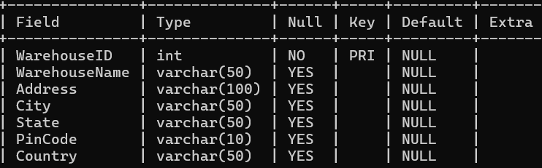

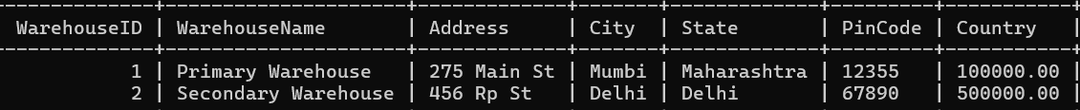
Warehouse Details
Warehouse Information
WarehouseID
Warehouse Name
Address
City
Pin Code
Country

Slide 8

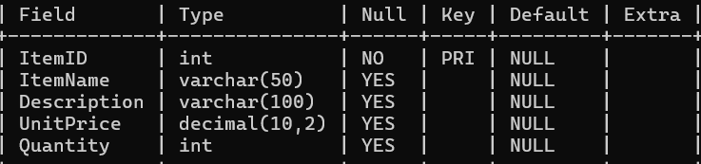
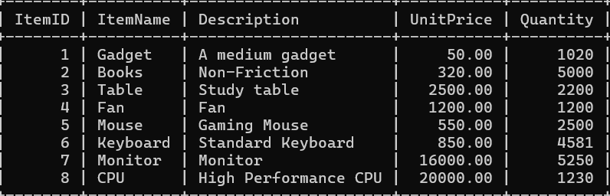


Items Table
Helps to manage item details, quantity available
Table consisting of details related to Items-
ItemID
Description
Unit Price
Quantity

Slide 9

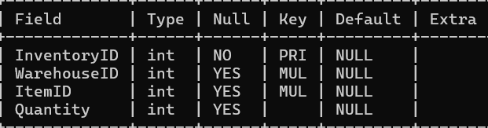
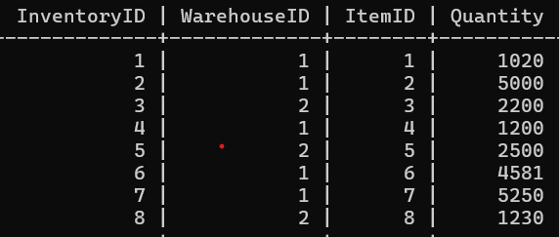
Inventory Table
Use to track Inventory level in warehouse on any item.
Morden way to check availability of stock for any order
Can help to check which item is available in which warehouse for proper order shipment

Slide 10
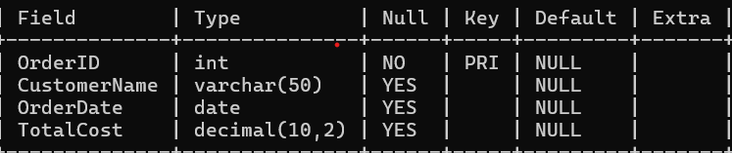
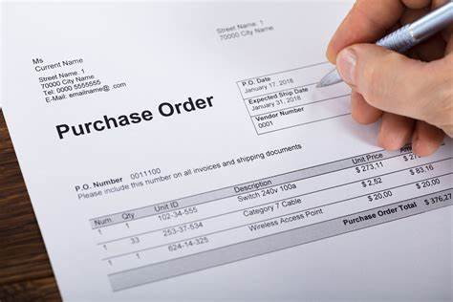
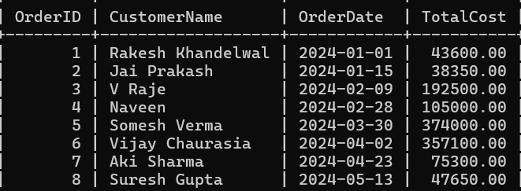
Orders Table
Use to Manage orders of any costumer
Order date and total cost can be seen, deleted, updated or new can be added

Slide 11

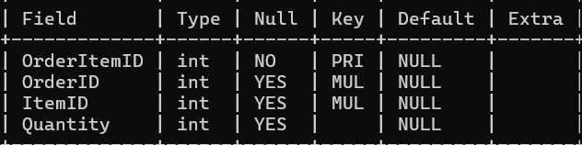
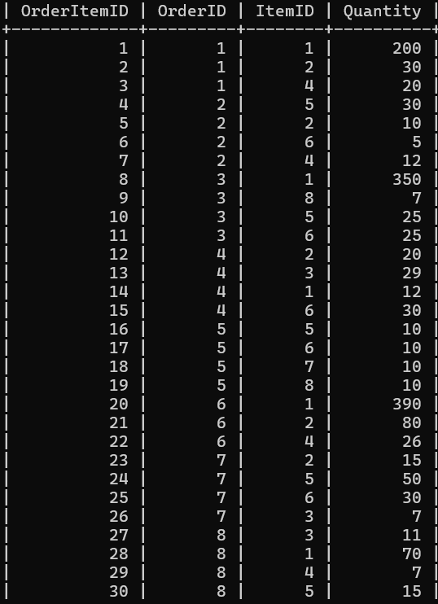

Order Items Table
By the help of given order ID used to find Order detail
Morden way to track orders what item is ordered in what quantity

Slide 12
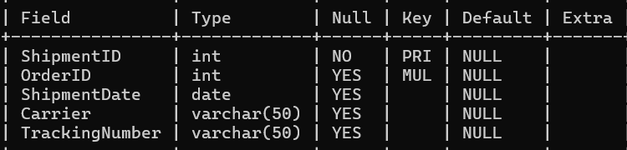

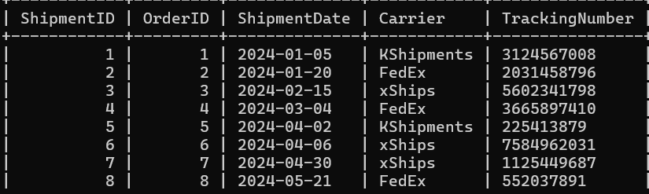
Shipments Table
Used to shipment details of Orders Shipped
Unique Shipment Id is used for office staff
For client Tracking ID is used

Slide 13

Thank You

